Slide 1
Finding and Running Cmdlets

Slide 2
In this Video, we are going to take a look at…
Verb-Noun – parameters pattern
Tab complete and using the arrow keys
Using Help to find Cmdlets
Using Get-Command to find Cmdlets
Measuring commands for performance
Using Aliases

Slide 3
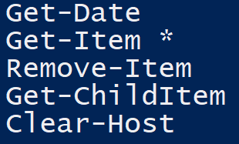
Standard PowerShell Cmdlet Pattern
The standard pattern for Cmdlets is –
Verb-Noun
Examples –
Get-Date
Set-Content
Remove-Item
Clear-Host

Slide 4
Using the Help System and Protecting with -WhatIf and -Confirm
Next Video

